Slide 1
NOSTRADAMUS input data preparation
RSN workshop presentation

Slide 2
“For forty years the rainbow will not be seen.
For forty years it will be seen every day.
The dry earth will grow more parched,
and there will be great floods when it is seen.”
Nostradamus

Slide 3
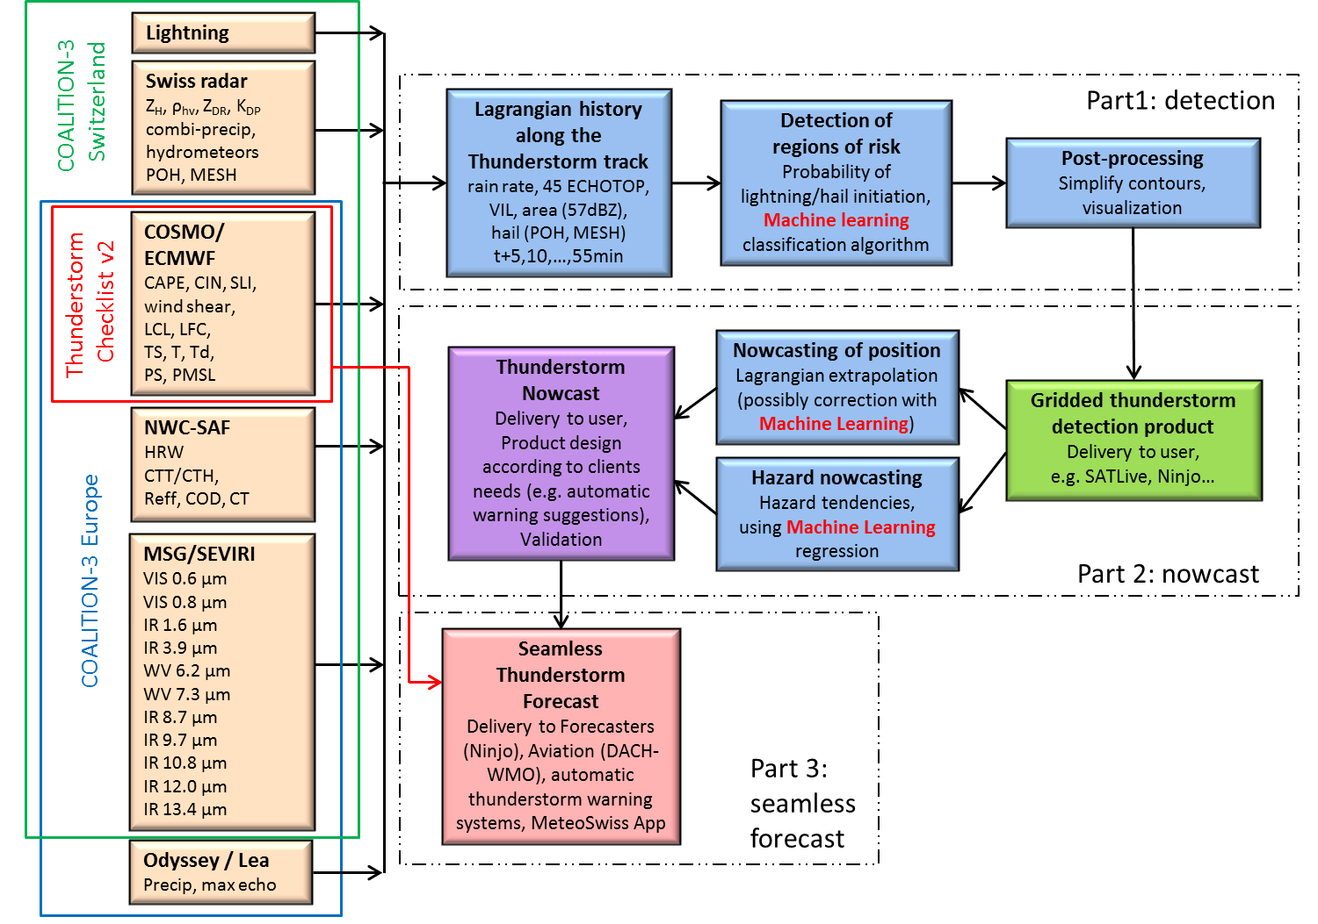
Context – NOSTRADAMUS project
Obs data
(original format)
?

Slide 4
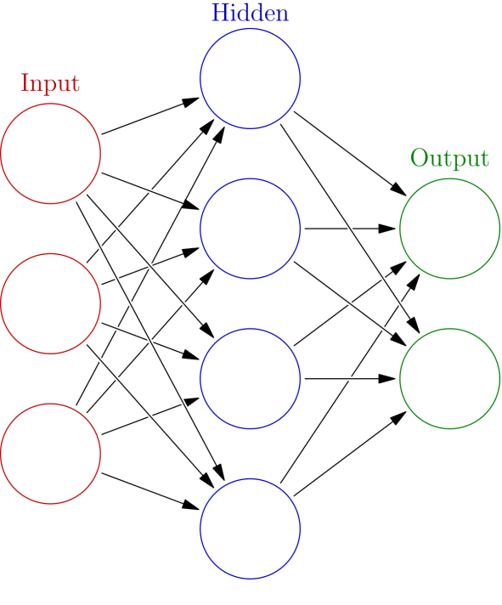
Problem formulation
Obs data
(original format)
?
Goal of the code
Read data from various sources and time steps into uniform numpy arrays.
Spatially displace the data from past time steps along a flow path to the most recent time step t0.
Evaluate the displacement by calculating skill scores for the displacement accuracy.

Slide 5
Context – NOSTRADAMUS project
Obs data
(original format)

Slide 6
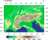
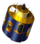
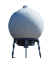
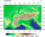
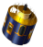

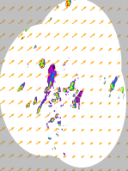
Reading the original data
Show example
07.07.2015 14:40 UTC
Obs data
(original format)
Obs data
(.npy or .nc file)
t0
t-30min
2 – x-dim
Uniform Numpy array
1 – y-dim
0 – Time: t0 | t-5 | t-10…

Slide 7
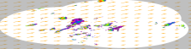
Deriving optical flow field
Show example
07.07.2015 14:40 UTC
Obs / UV data
(.npy or .nc file)
Magic
(aka Optical Flow)
a
2 – x-dim
RZC Rain Rate
UV-Fields & Displacement Array
1 – y-dim
0 – Time: t0 | t-5 | t-10…
0 – Time: t0 | t-5 | t-10…

Slide 8
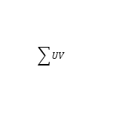
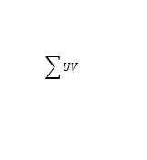
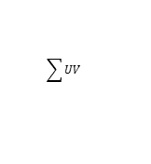
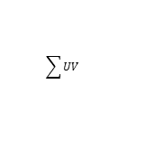
Displacing fields
Show example
07.07.2015 14:40 UTC
Obs / UV data
(.npy or .nc file)
t-30
t-25
t-20
t-15
t-10
t-5
t0
$$\sum{UV}$$
$$\sum{UV}$$
$$\sum{UV}$$
$$\sum{UV}$$
$$\sum{UV}$$
$$\sum{UV}$$
Semilagrangian displacement

Slide 9
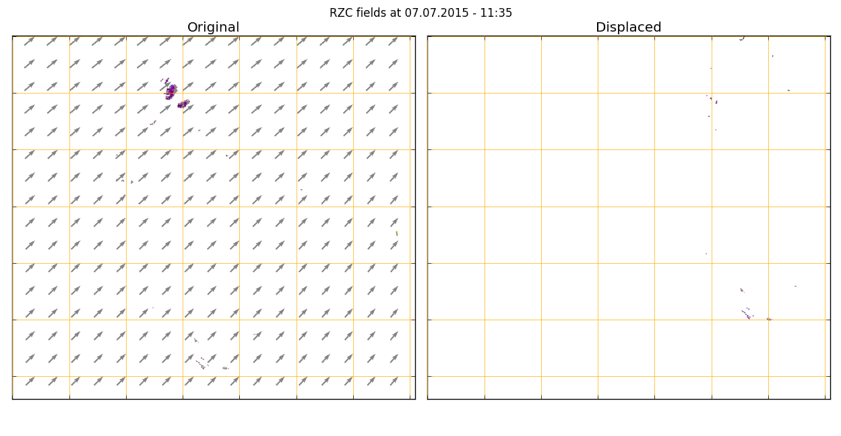
Comparison original / displaced fields

Slide 10
Correcting for residual movement
Show example
07.07.2015 14:40 UTC
Obs / UV data
(.npy or .nc file)
t-30
t-25
t-20
t-15
t-10
t-5
t0
$$\sum{UV}$$
$$\sum{UV}$$
Semilagrangian displacement
a
Magic
2 – x-dim
Displaced RZC Rain Rate
Residual UV-Fields & Displacement Array
1 – y-dim
0 – Time: t0 | t-5 | t-10…
0 – Time: t0 | t-5 | t-10…

Slide 11
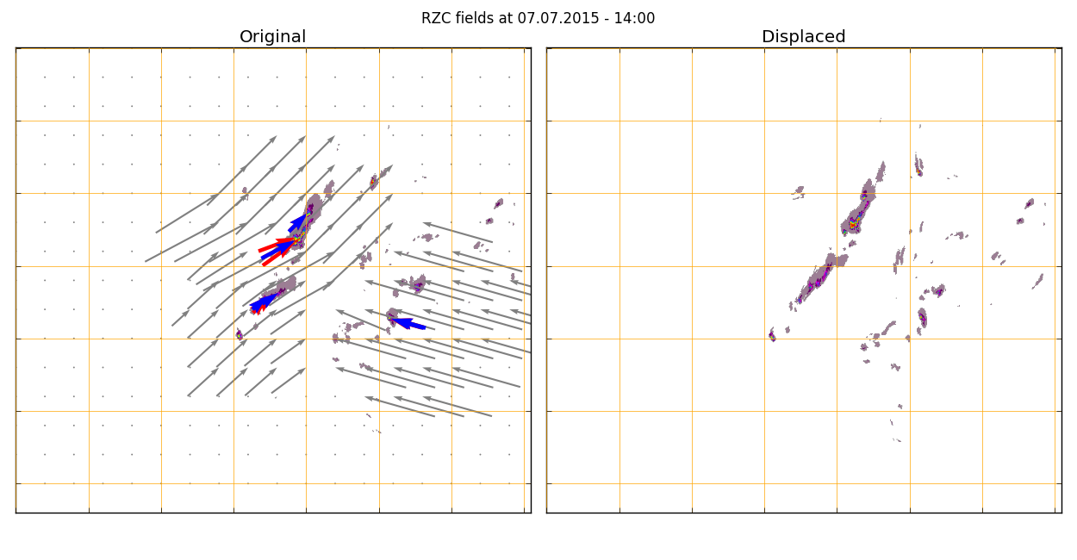
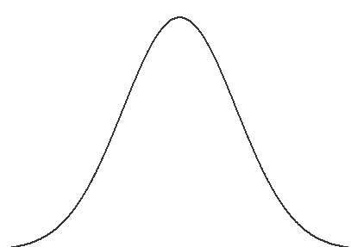
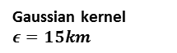

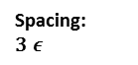

Zero motion vectors $\vec{0}$
Area with no zero motion vectors
Spacing:
$$3 ε$$
Radius: $15 ε$
Gaussian kernel $ε=15km$
Displacement to virtual position at 14:40 UTC

Slide 12
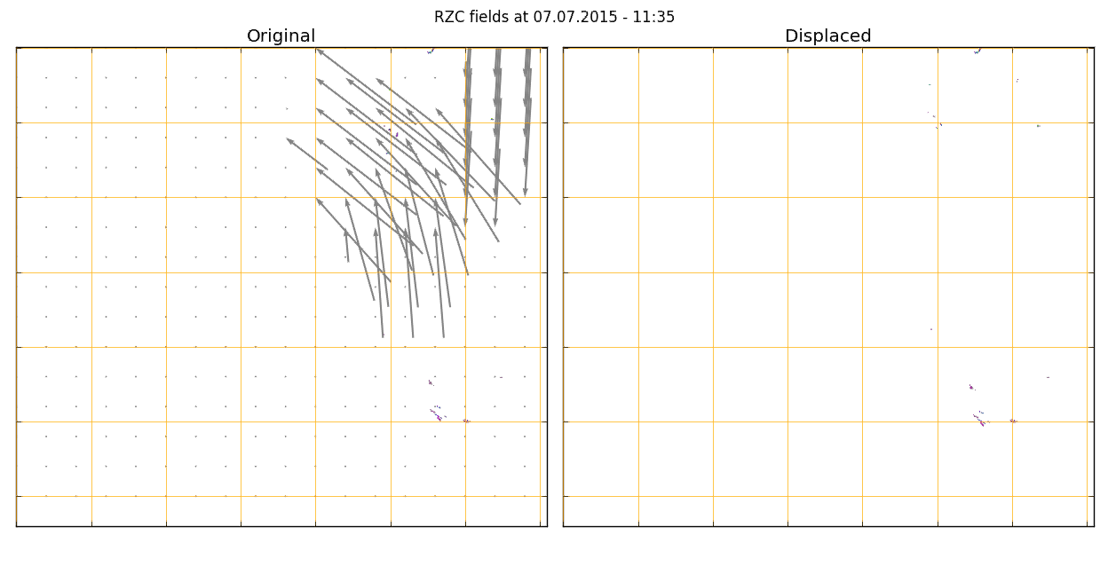
Displaced / residually displaced fields

Slide 13
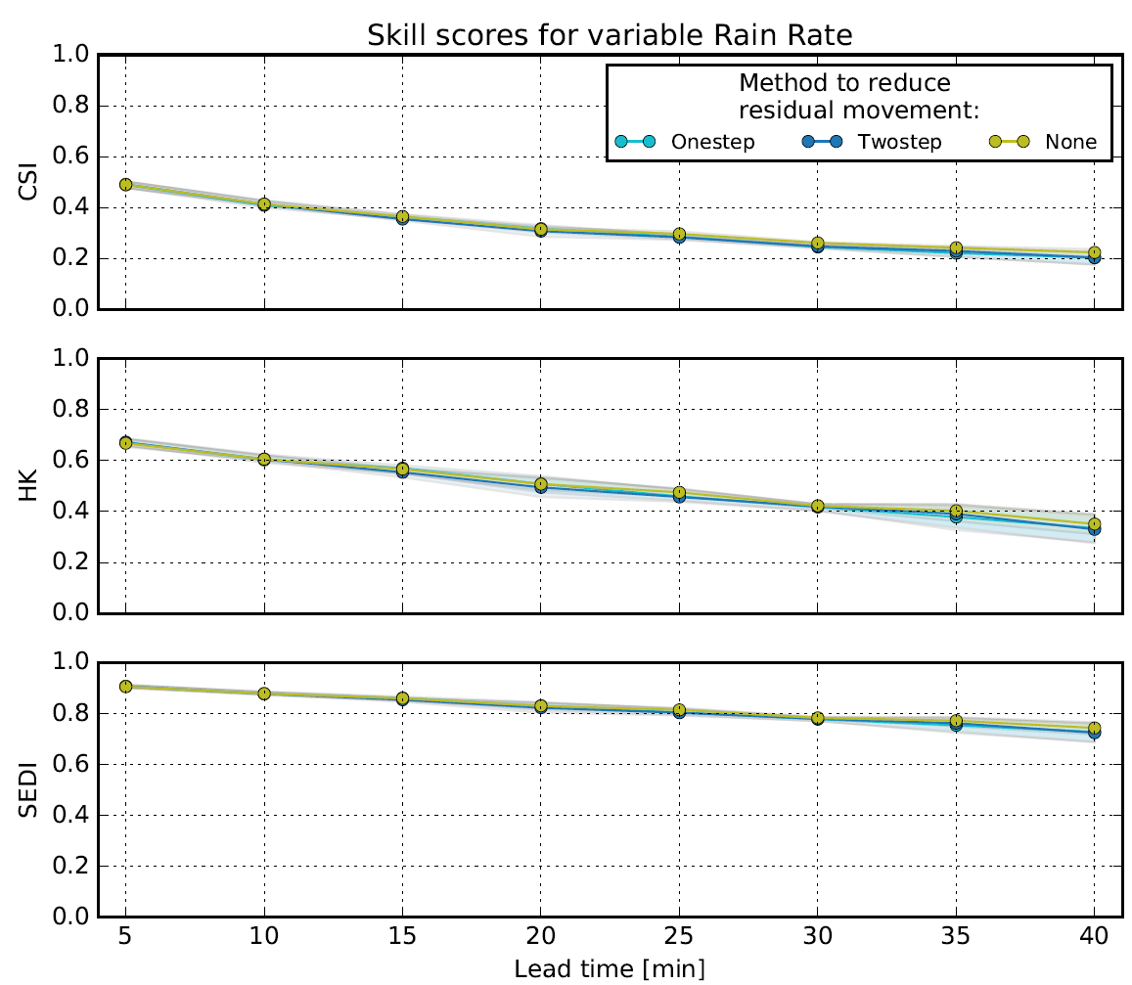
Is secondary displacement necessary?
No secondary displacement
With secondary displacement

Slide 14
Updating step
07.07.2015 14:45 UTC
Obs data
(original format)
Obs data
(.npy or .nc file)
t-30
t-25
t-20
t-15
t-10
t-5
t0
$$\sum{UV}$$
$$\sum{UV}$$
Semilagrangian displacement
t0
Magic
2 – x-dim
2 – x-dim
1 – y-dim
Uniform Numpy array
0 – Time: t0 | t-5 | t-10…
1 – y-dim
0 – Time: t0 | t-5 | t-10…

Slide 15
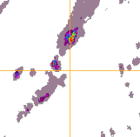
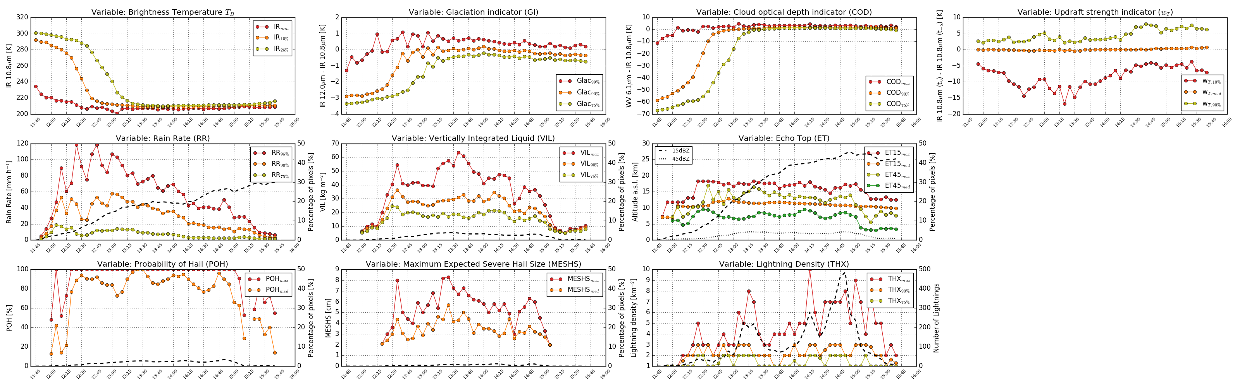
Langrangian history along TS track

Slide 16
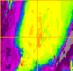
Langrangian history along TS track

Slide 17
Input to ANN

Slide 18
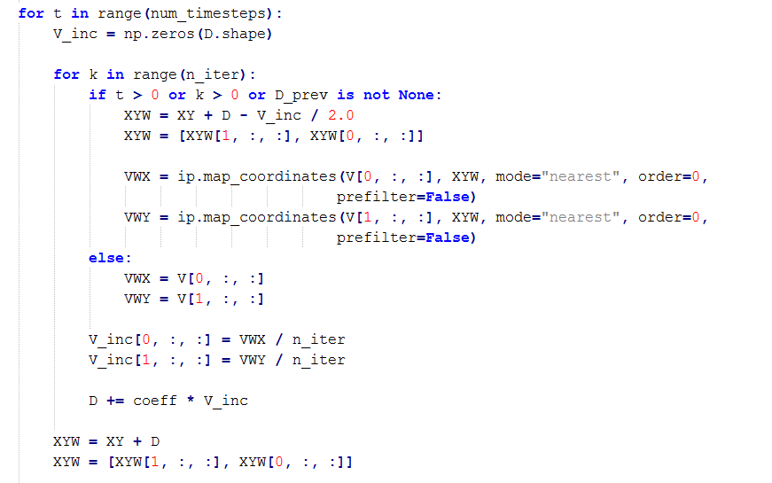
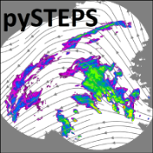
Open points
07.07.2015 14:12 UTC
…
COSMO wind and convection fields
Extraction of XYW fields from semilagrangian displacement procedure, to avoid for loop for every displacement.
Apply TRT cell detection on displaced fields?
Check compatibility with pySTEPS

Slide 19
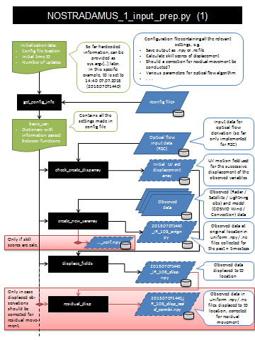
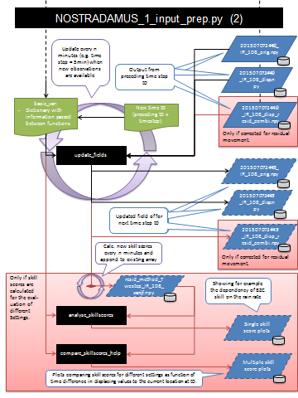
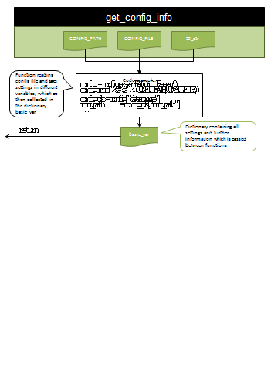
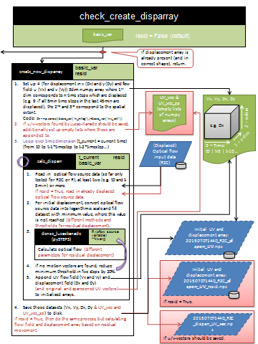
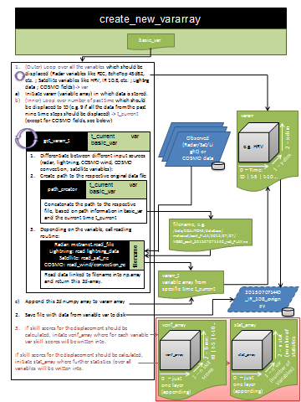
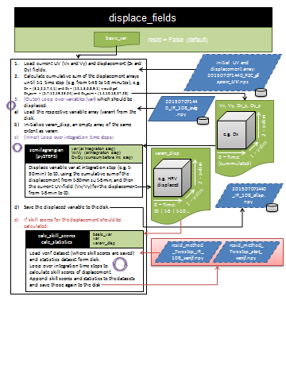
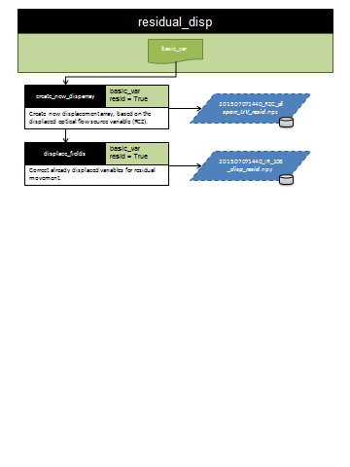
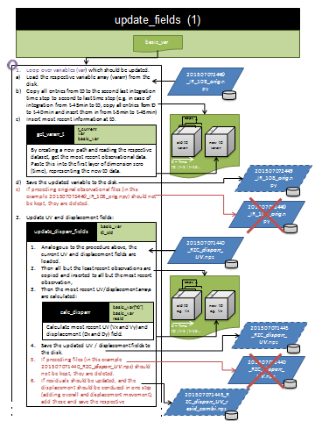
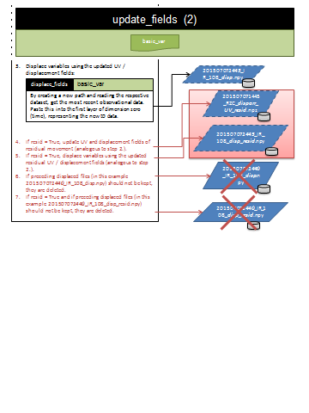
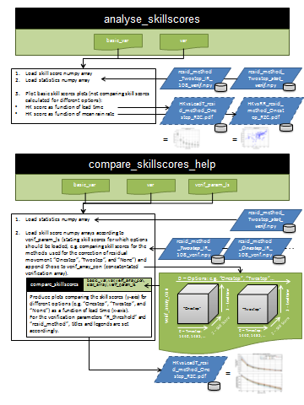
Manual (under construction)

